Slide 1
Attribute cases

Slide 2
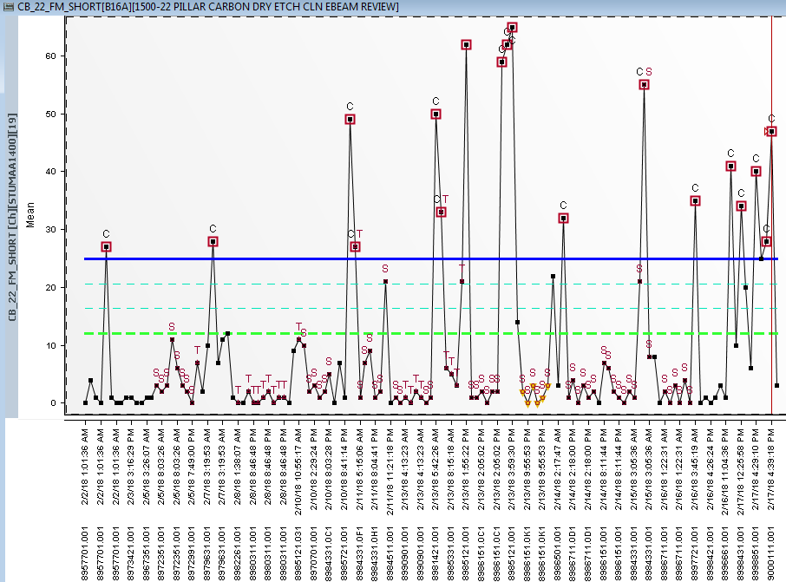
B16A_1000-22 PILLAR CARBON DRY ETCH CLN MICRO INSP
CB_22 FM SHORT – ZDEP22SP-ETCHEPALG/A1L22BK1B2
  Issue
  B16A_9000111.001 W04,W25-2/2 affected
  Random fm short defects
  Intermittent OOC for past 1 week
  Root Cause
  Based on GA from 22OPOP onwards observe toggle to
  5030-22 PILLAR NITRIDE BACKSIDE DRY ETCH-APXTAABB00 tied with attribute:ZDEP22SP-ETCHEPALG-100% conversion.

Slide 3
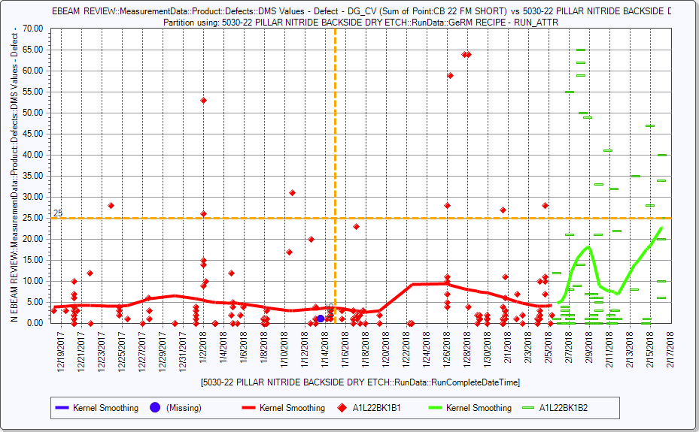
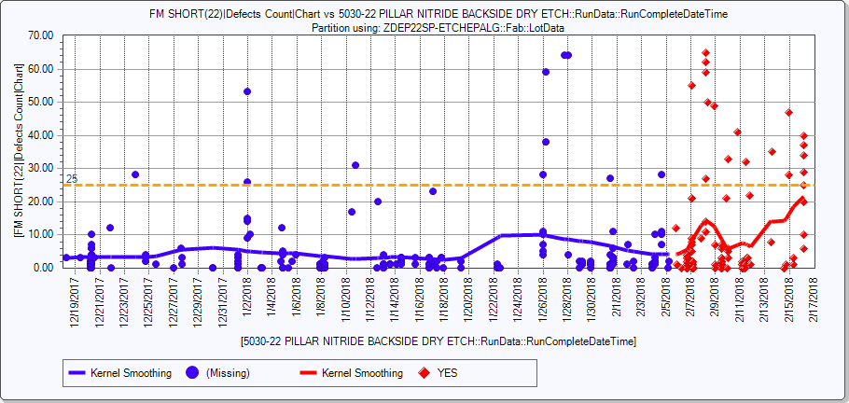
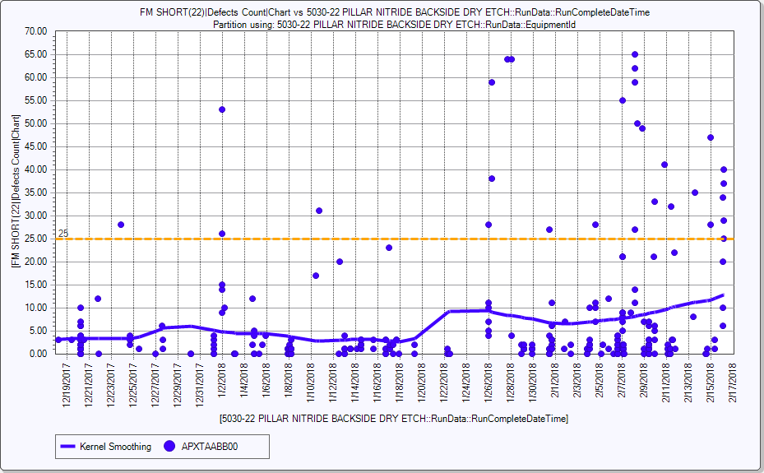
CB22 FM SHORT vs 3500-22 PILLAR CARBON DRY ETCH
Scan recipe change
By recipe
By ATT
By TOOL

Slide 4
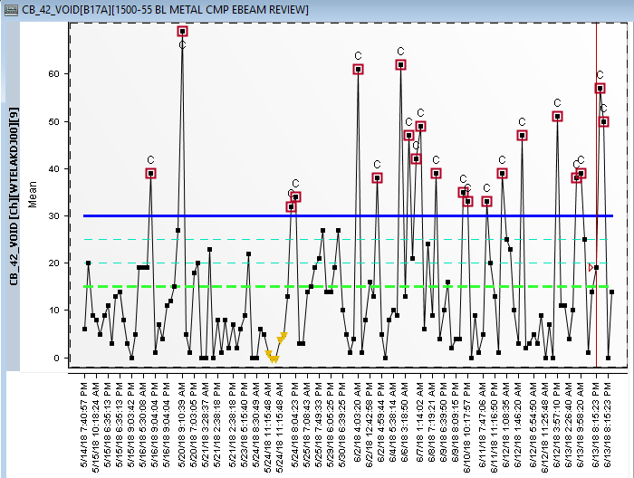
B17A_1000-55 BL METAL CMP MICRO INSP
CB42 VOID
  Issue
  B17A 9155641.001 w18 & w03 (2/4 review fail)
  No SWR/QDR/ENG REQ related : cmp req –Not related
  Defect location random
  NO RDA scan/review tool/recipe changed
  Number of review defect no changed
  No any other defect trending down
  TAD/TRD-no drift
  Root Cause
  ZCVQ55MP-ARCDFTRPTIP-from CVD-100% converted
1.Conversion background and motivation:
-55ARC UAG C2/B2 recently hit with bear claw CB55 bridging shading at 55METAL SPUTTER scan/review. RF Purge modification are known to help remove particles as well as bear claw shading.
-DARC is specified as future 110s constraint WS, therefore MAXOUT will be done by (a) extending periodic clean from 12 pairs 1 clean to 13 pairs 1 clean (b) reducing final pump time from 10s to 7s.
RF Purge modification, 13X clean, and 7s Final Pump has been implemented across DARC recipes,

Slide 5
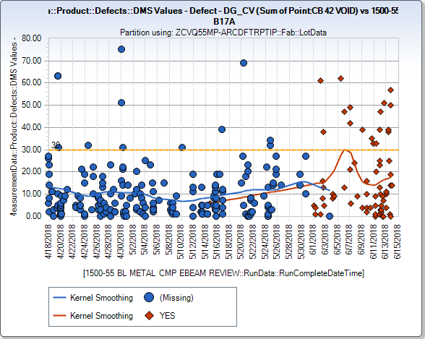
CB42 VOID vs ZCVQ55MP-ARCDFTRPTIP

Slide 6
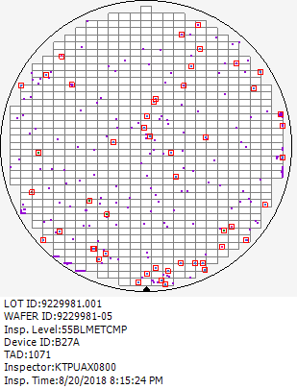
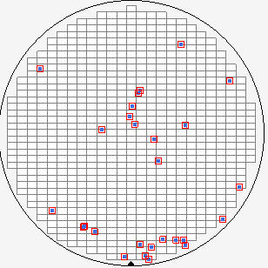
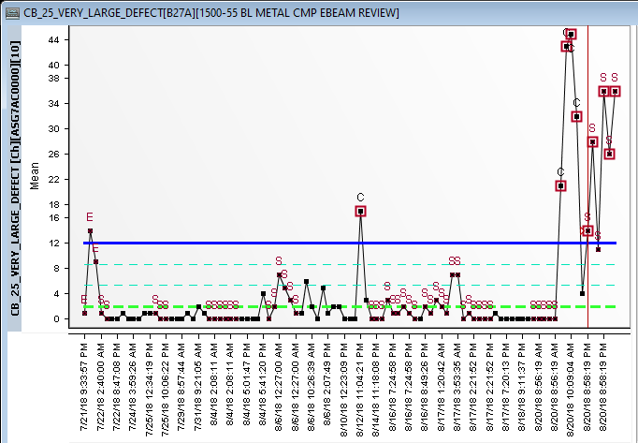
B27A_1000-55 BL METAL CMP MICRO INSP
CB25 VERY LARGE DEFECT –ZCMP22SPCR9.5PROC
  Issue
  B27A 9229981.001 (4/4) Fail CB25 Very Large Defect
  Root Cause
  ZCMP22SPCR9.5PROC
  (1.Conversion background and motivation
  −CR 9.5 ALD/RTO splits with Fresco Nit Backside Dep post poly dep 4
  for stress relieve observed lower Goodness of Fit (GOF) at pre and post measurement of 22PCMP
  -Delta thickness mean is lower as well, thus to create attribute for process separation to prevent R2R false tuning
Large defect
2 lots

Slide 7
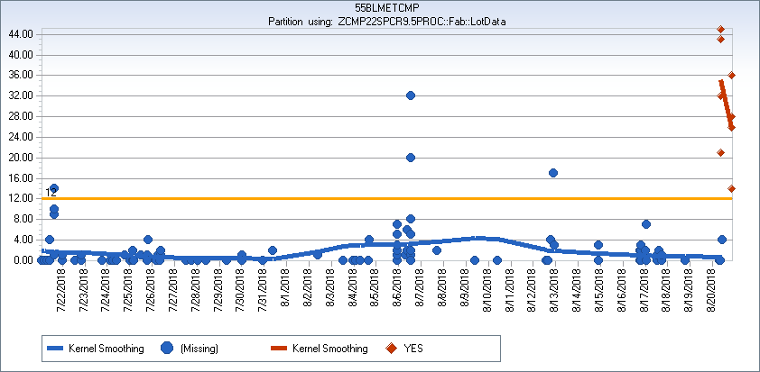
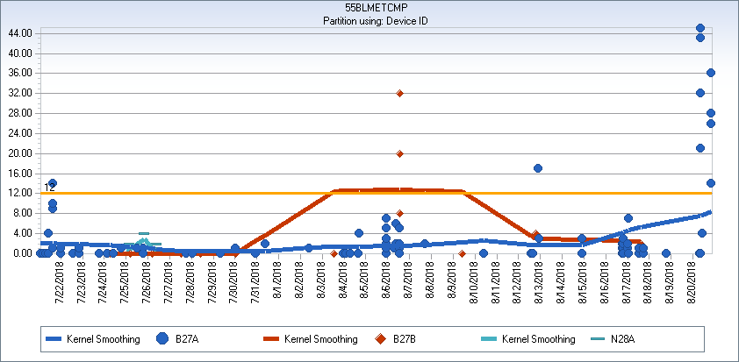
Different type
By Part Type

Slide 8
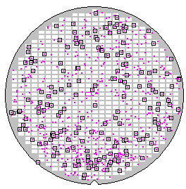
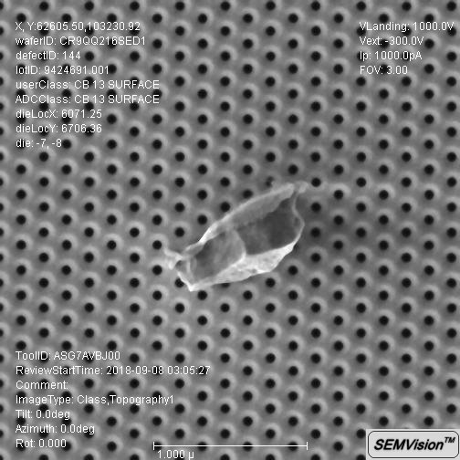
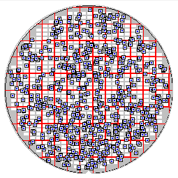
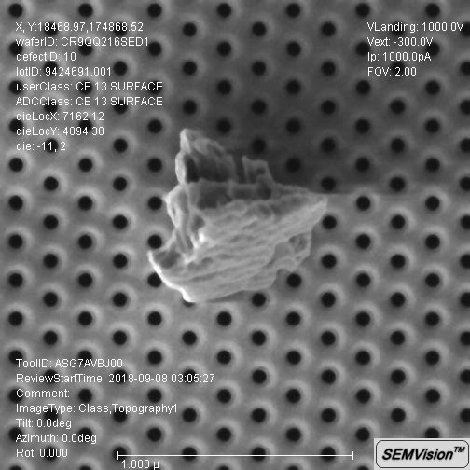
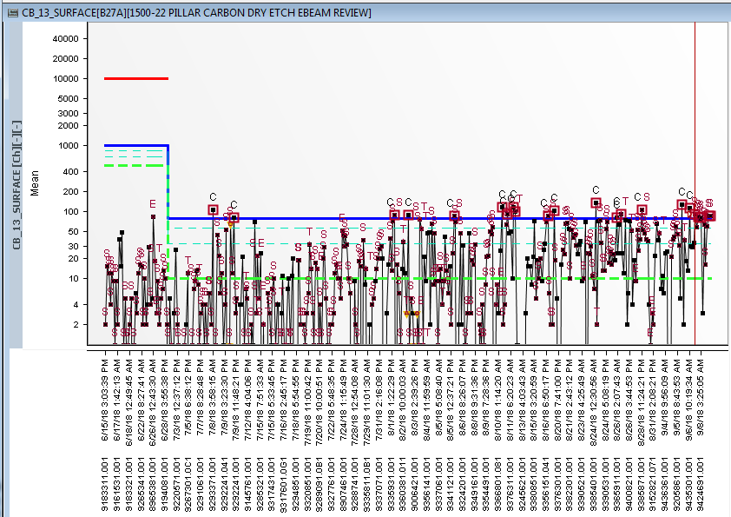
B27A_1000-22 PILLAR CARBON DRY ETCH MICRO INSP
CB13 Surface – Attribute ZDEY22MPDDEIDEW5HXP
  Issue
  B27A Surface baseline shifted since 08/01 ( RDA inspection time )
  Rootcause
  Suspect Attribute : ZDEY22MPDDEIDEW5HXP related
  Conversion background and motivation
  This conversion is to evaluate 22L W5 Package comprising of 22DDE ME0 with Hydra coupled with 22INT DE W5 Recipe on 22HXP Final configuration hardware (Corvus-T+CIP Combo)
  Conversion Rate: 100%
Cumm Map
Surface

Slide 9
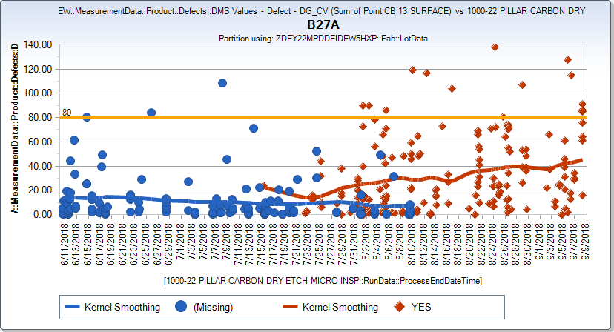
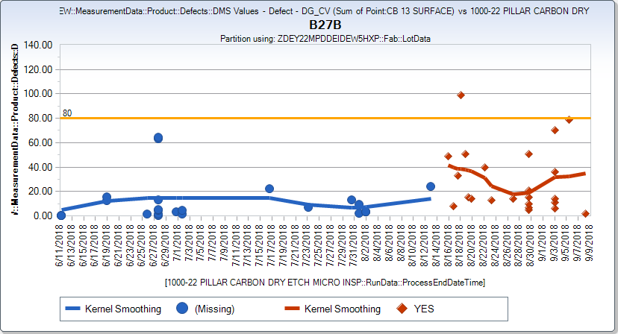
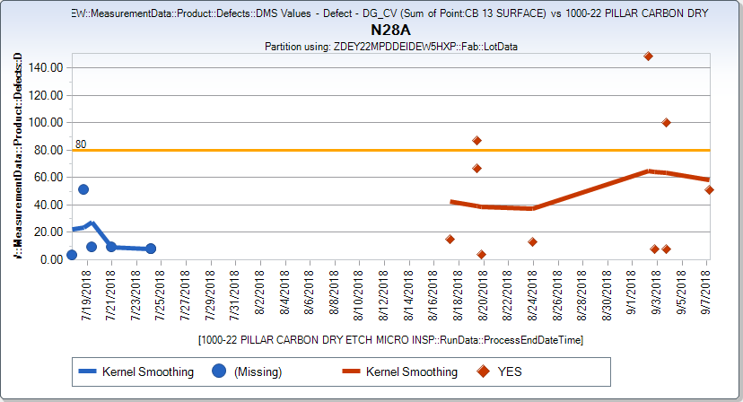
CB13 Surface vs Attr ZDEY22MPDDEIDEW5HXP
D42_Chamber

Slide 10
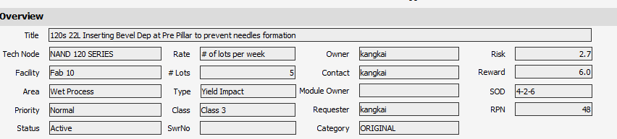
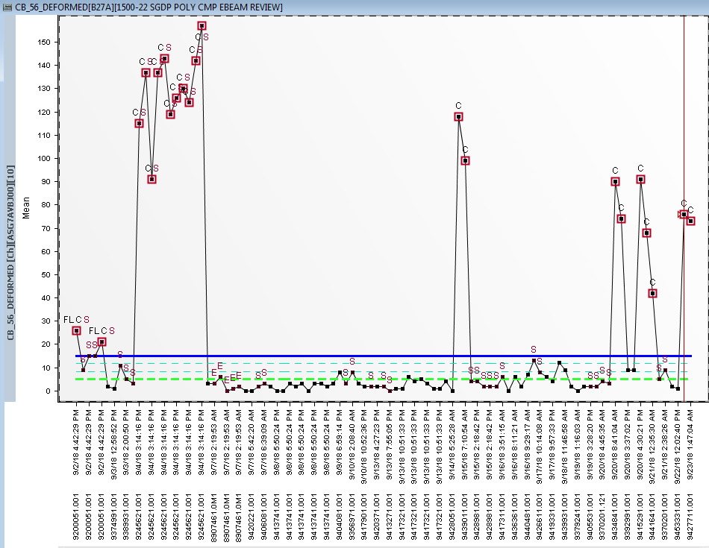
B27A_ 1000-22 SGDP POLY CMP MICRO INSP
CB56_DEFORMED–ZWPY22MFBEVELINST
  Issue
  B27A_ 9427711.001_W14,W25 2/2 rev affected
  Random shading of deformed defects.
  Scan due to tag lot for ZWPY22MFBEVELINST
  Multiple OOCs in past 1 week.
  Root Cause
  Based on affected lots-commonality points to
  ZWPY22MFBEVELINST from WET
  120s 22L Inserting Bevel Dep at Pre Pillar to prevent needles formation
  Conversion only for B27A -5 lots per week
a. Conversion background and motivation - 22L Pillar etch is damaging bevel by creating needles and those defects are deem to be the source of defect toggling blocked CGR. Inserting bevel Carbon as bevel protection and prevent needles formation.
b. Process changes/ Technical explanation
- bevel carbon process:
Darc Strip: 20s NF3+22s O2
Carbon Deposition: 10s He Pre-Treat with 51s carbon dep process
c. Need Date and Priority
-Need Date: ASAP
d. Possible Gain and downside and follow up action
- bin dt gain
Carry over shading-different issue

Slide 11
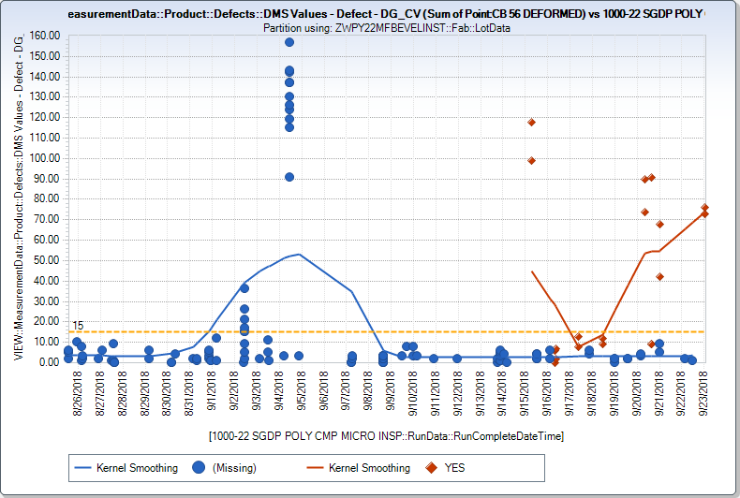
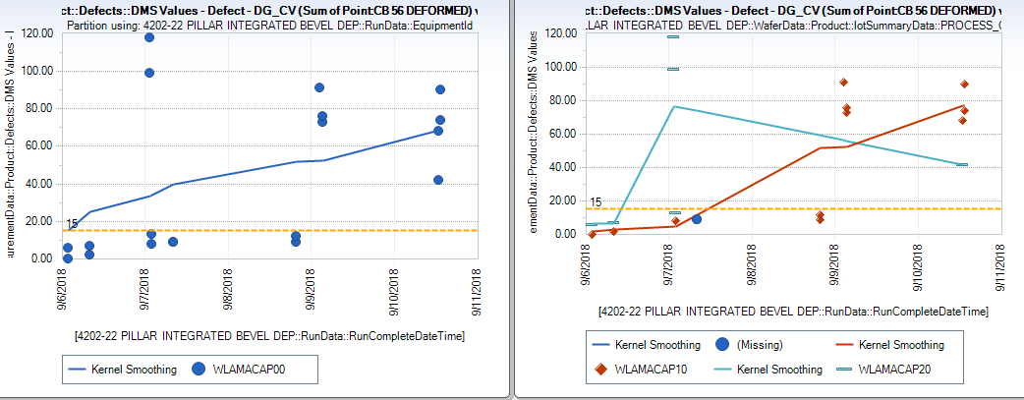
CB_56 DEFORMED VS ZWPY22MFBEVELINST
CB_56 DEFORMED VS 4202-21INT BEVEL DEP
TOOL
CHAMBER

